Slide 1

70 East Lake Street Suite 1700 Chicago, IL 60601 www.ctbaonline.org
Gentrification and Property Tax Exemptions in the City of Chicago
October 2, 2020

Slide 2
NHS clients’ characteristics
Median annual income of $61,980
$200,000 as the assumed typical home value
$2,000 in annual property taxes for a typical NHS client (1% of home value and less than 4% of annual income)

Slide 3
Longtime Homeowner exemptions Requirements
10 + years as principal residence or who, at least 5 years if that person received assistance as part of a government or nonprofit program
Household income of $100,000 or less
“Adjusted Homestead Value”: the lesser of the following property’s base homestead value increase
10% increase for each year after the base year for qualified taxpayers with a household income ranging [$75,000, $100,000]
7% increase for each year after the base year for qualified taxpayers with a household income of $75,000 or less, or
The property's equalized assessed value for the current tax year minus the general homestead deduction

Slide 4
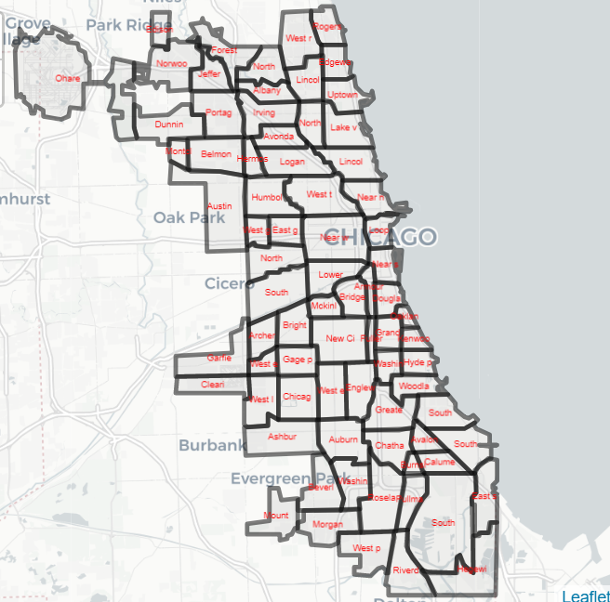
Neighborhoods in the City of Chicago

Slide 5
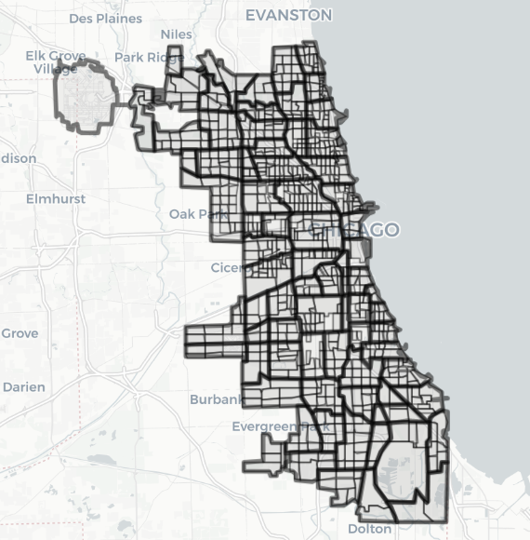
Neighborhoods and Tracts in the City of Chicago

Slide 6
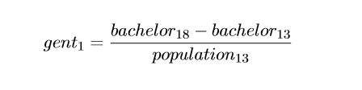
Gentrification definition #1
“Gentriﬁable” tract: household income must be below the median in 2013 ($58,676)
Definition 1: we use Tracts that experienced large positive changes (75th and 90th percentiles) in population aged+25 with a Bachelor Degree or Higher
Large positive changes in bachelor variable are a good indicator of displacements of high-income people

Slide 7
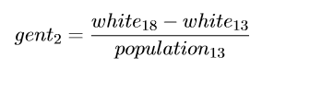
Gentrification definition #2
Definition 2: we use Tracts that experienced large positive changes (75th and 90th percentiles) in white population, excluding Latinos
Large positive changes in race demographics indicate where gentriﬁcation is likely to occur

Slide 8
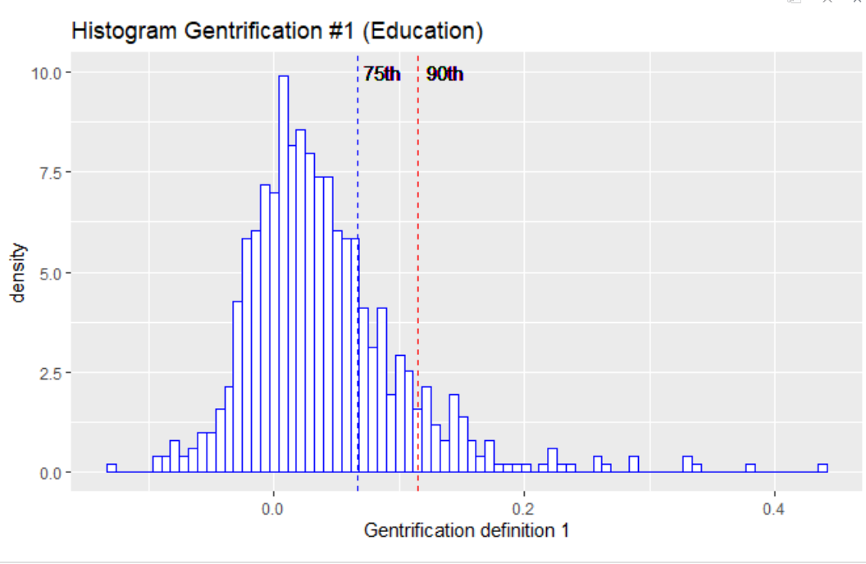
Visual representation of percentile 75th and 90th

Slide 9
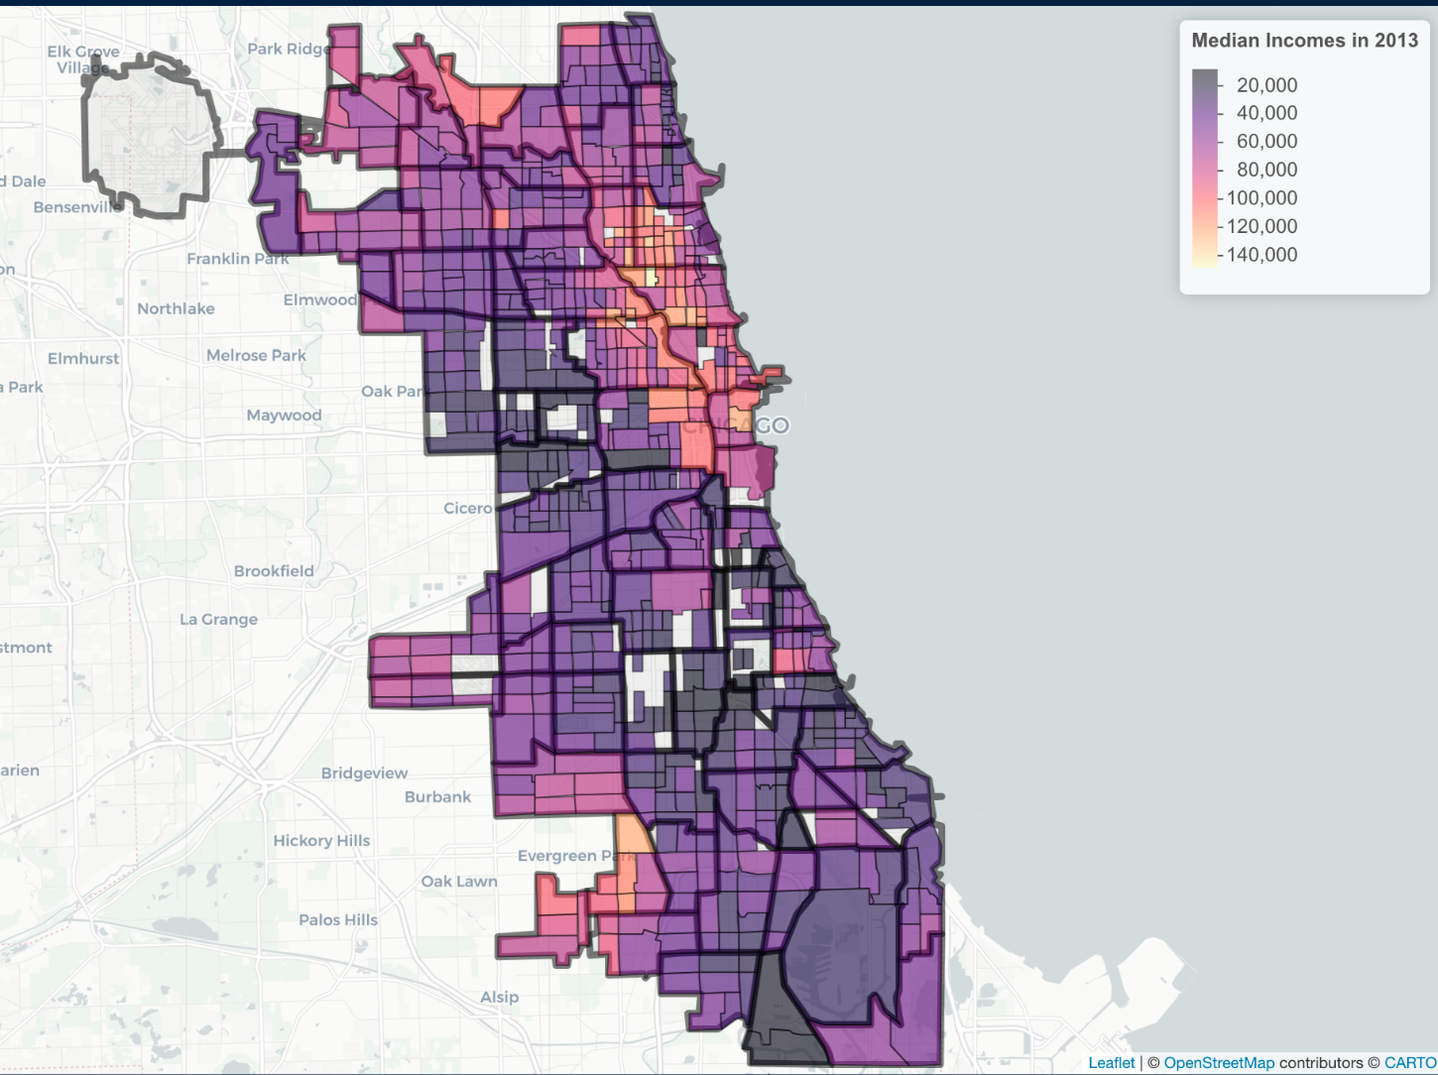
Median Household Income by Tracts in 2013

Slide 10
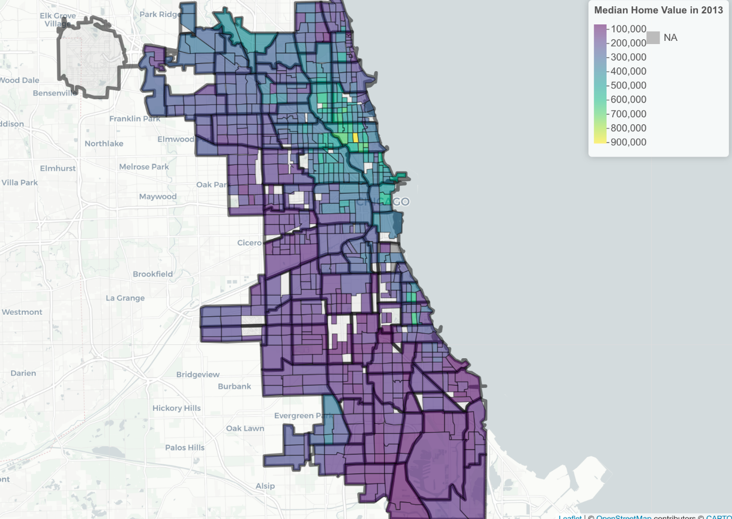
Median Home alue by Tracts in 2013

Slide 11
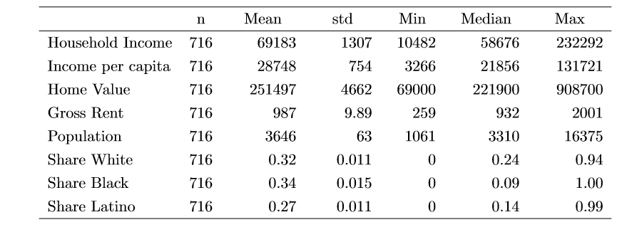
Income, Housing and Population in the City of Chicago by Tracts in 2013

Slide 12
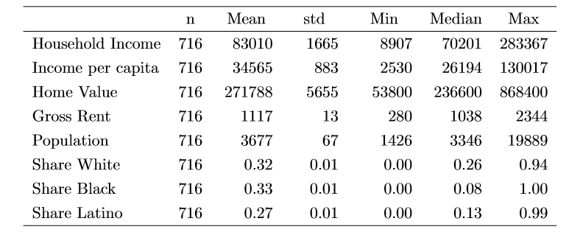
Income, Housing and Population in the City of Chicago by Tracts in 2018

Slide 13
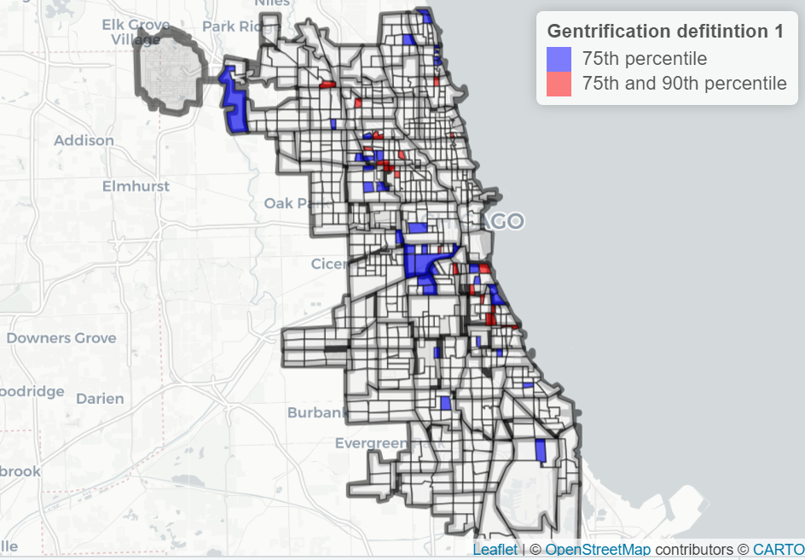
Gentrified Tracts under definition 1 for 75th and 90th percentile

Slide 14
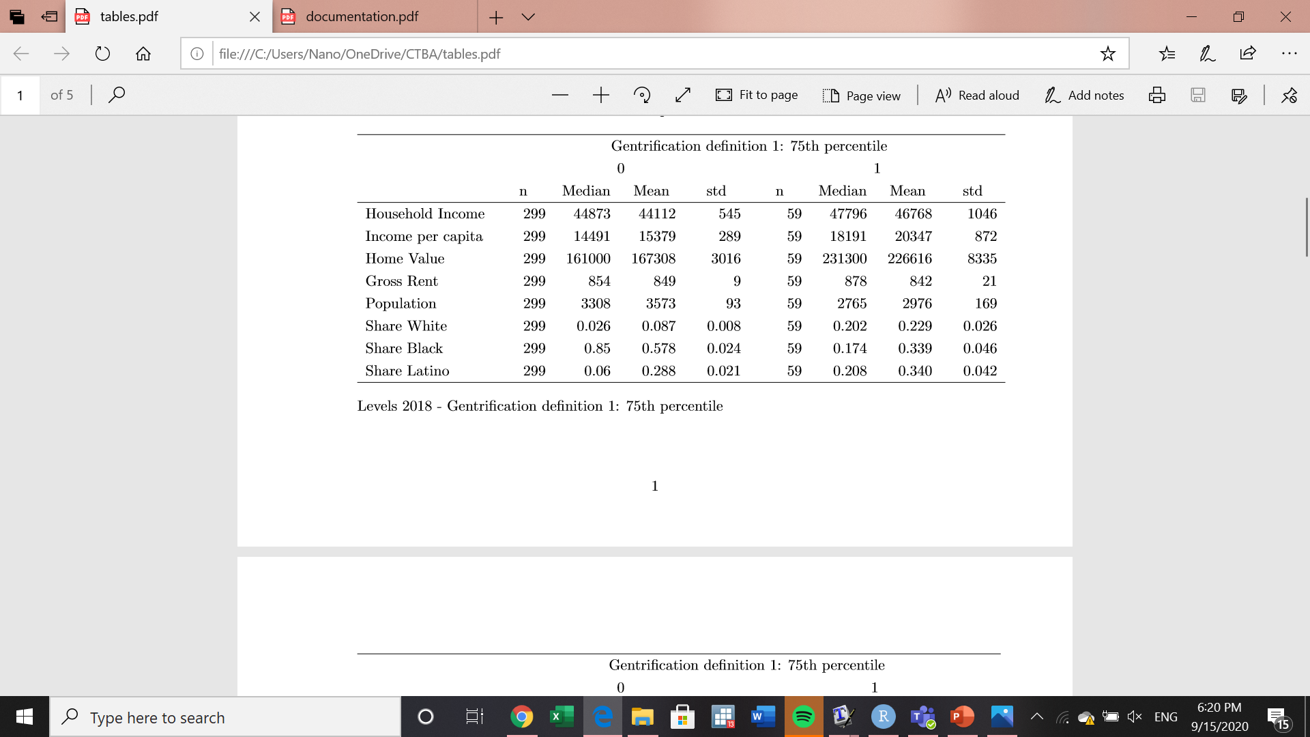
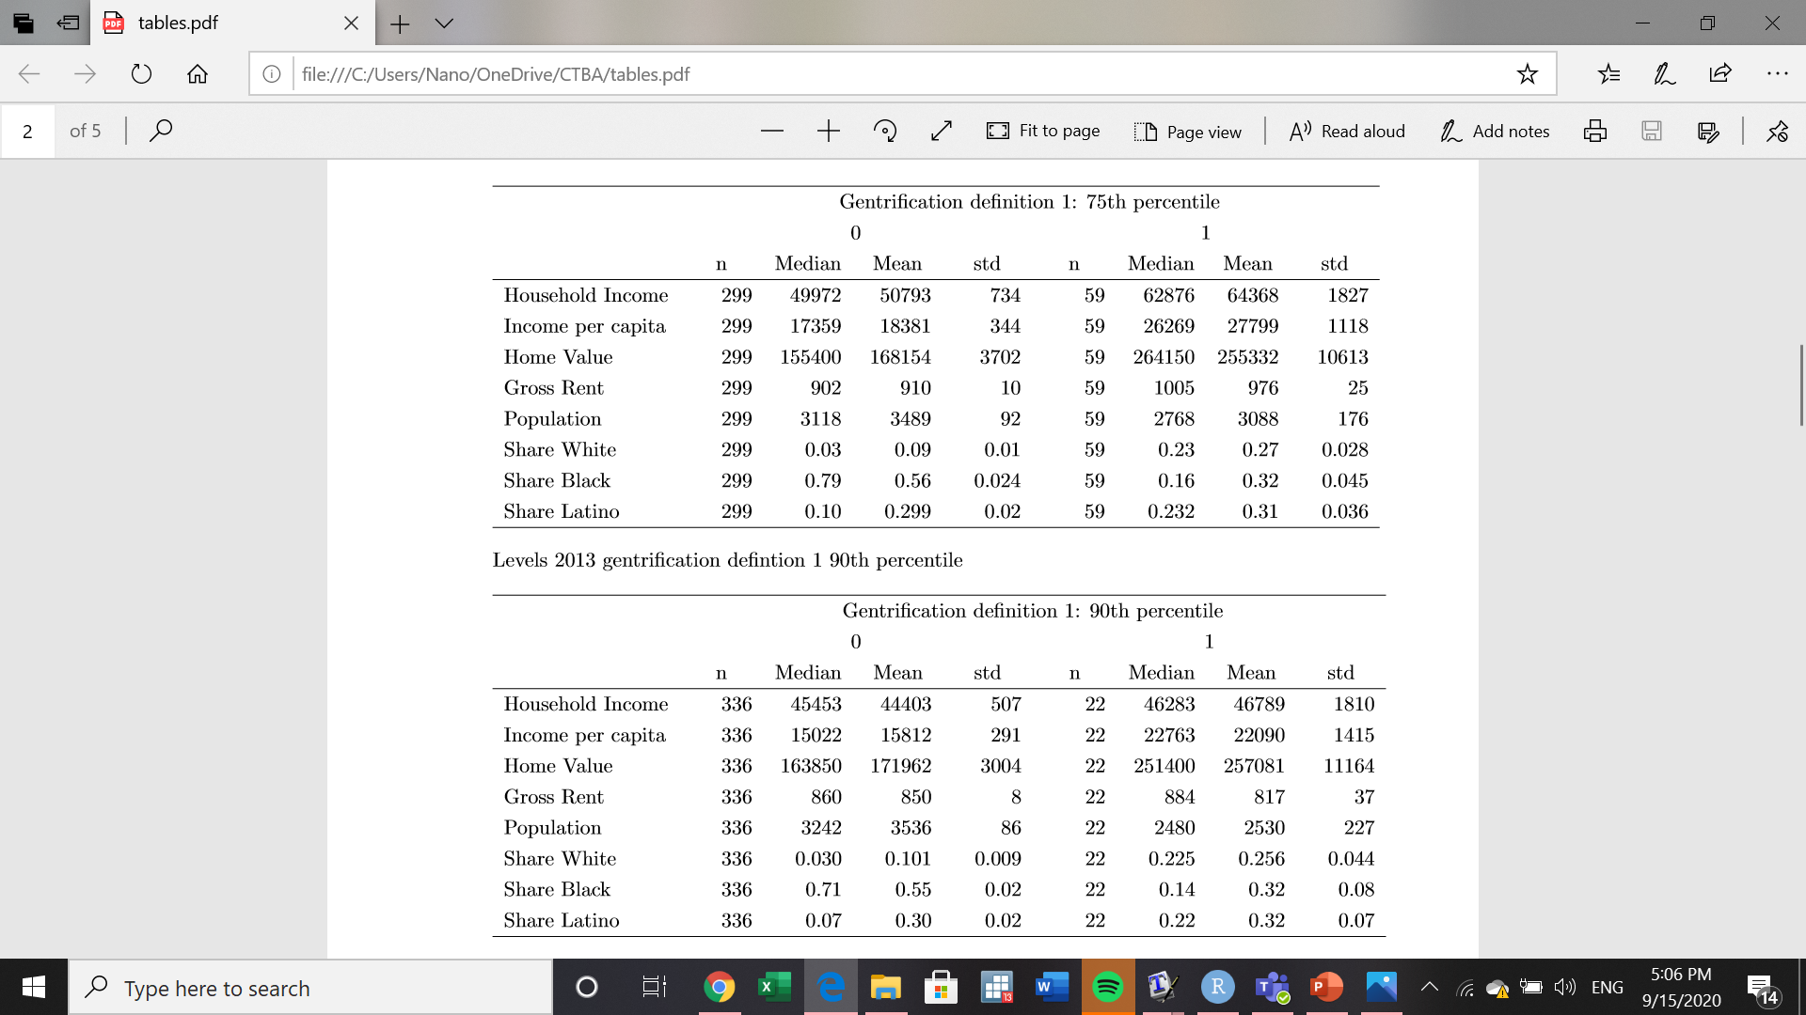
Summary Statistics – Def. #1 (75th per)
2013
2018

Slide 15
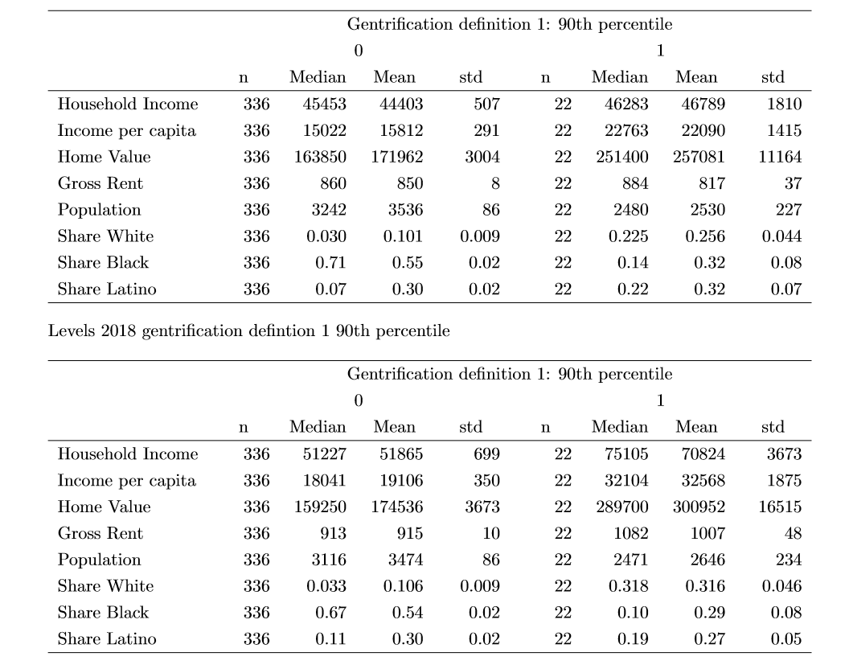
Summary Statistics – Def. #1 (90th per)
2013
2018

Slide 16
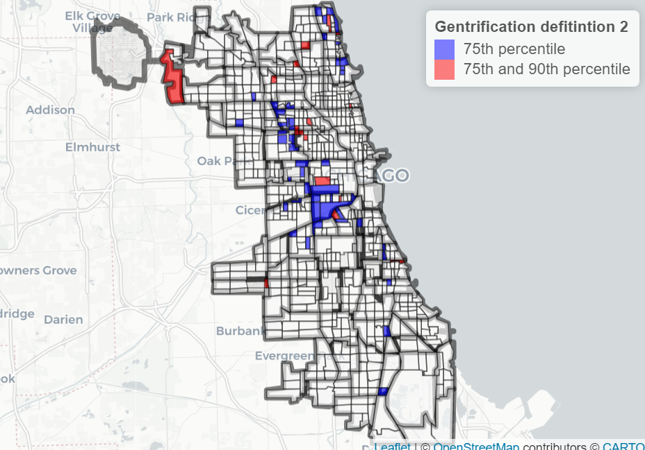
Gentrified Tracts under definition 2 for 75th and 90th percentile

Slide 17

Summary Statistics – Def. #2 (75th per)
2013
2018

Slide 18
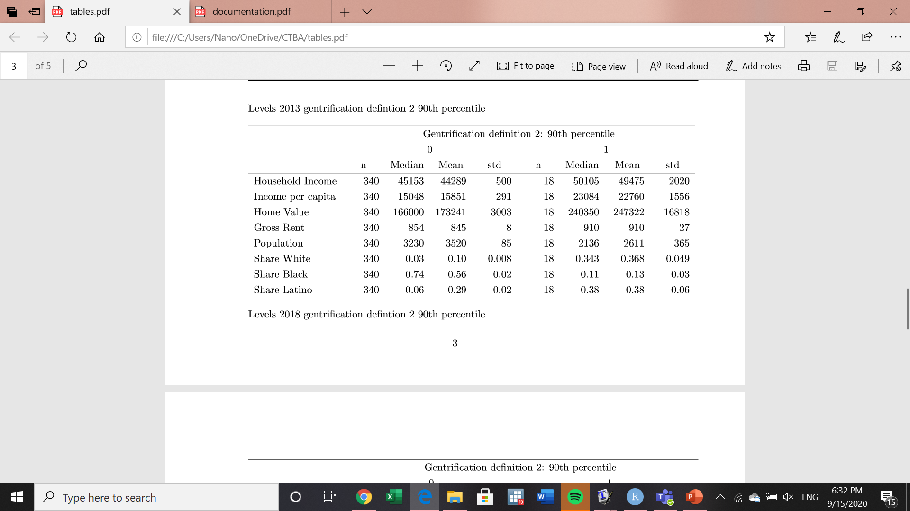
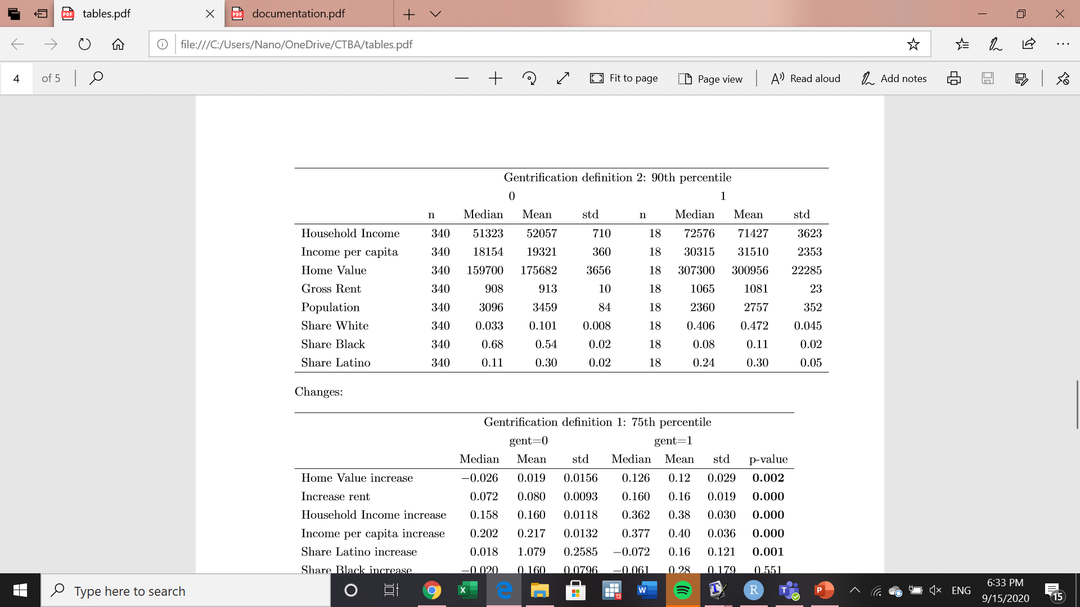
Summary Statistics – Def. #2 (90th per)
2013
2018

Slide 19
Comments on summary statistics for outcome variables
59 and 22 tracts meet definition #1 under the 75th and 90th percentile, respectively
64 and 18 tracts meet definition #2 under the 75th and 90th percentile, respectively
Gentrified tracts are initially less populated
Higher share of Latino population
Higher income and home values
Median and Mean rents are similar

Slide 20
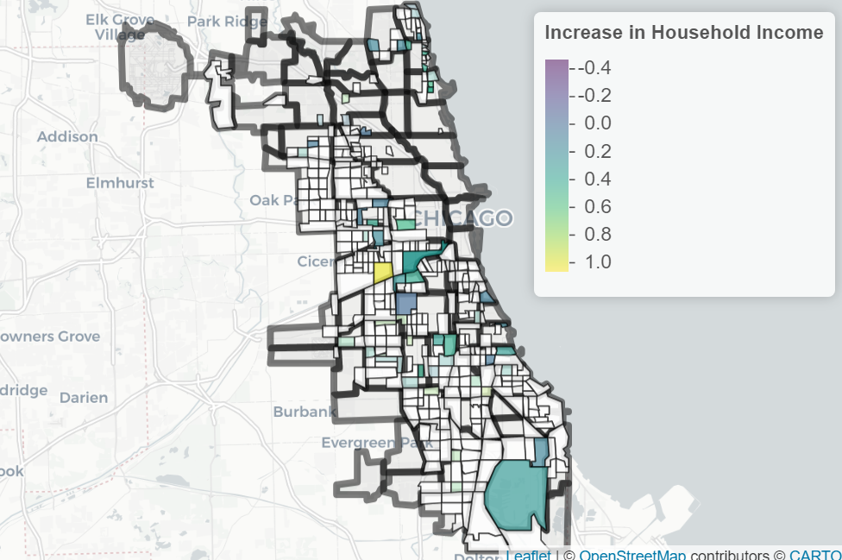
Increase in Median Household Income under definition 1 at the 75th percentile

Slide 21
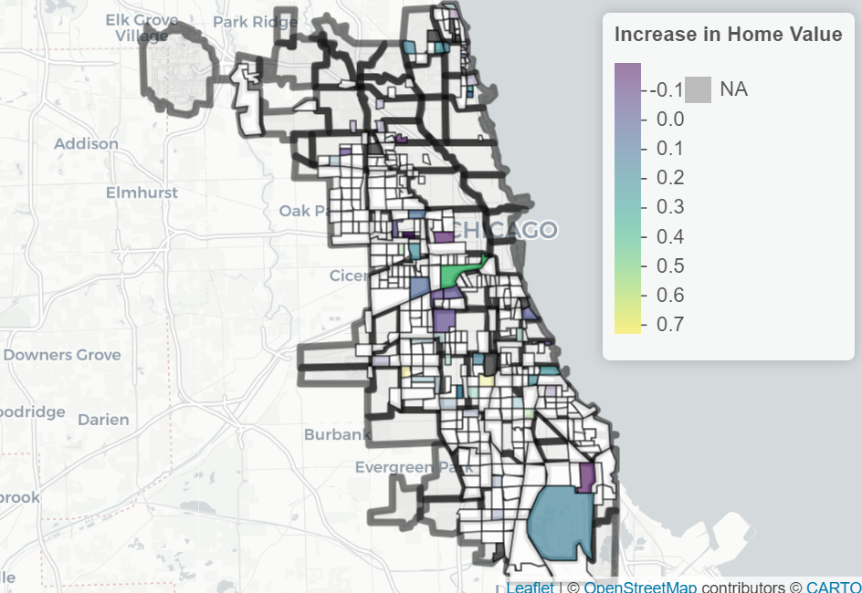
MAP of tracts increase home values under defition #1 at the 75th perc (use colors)

Slide 22
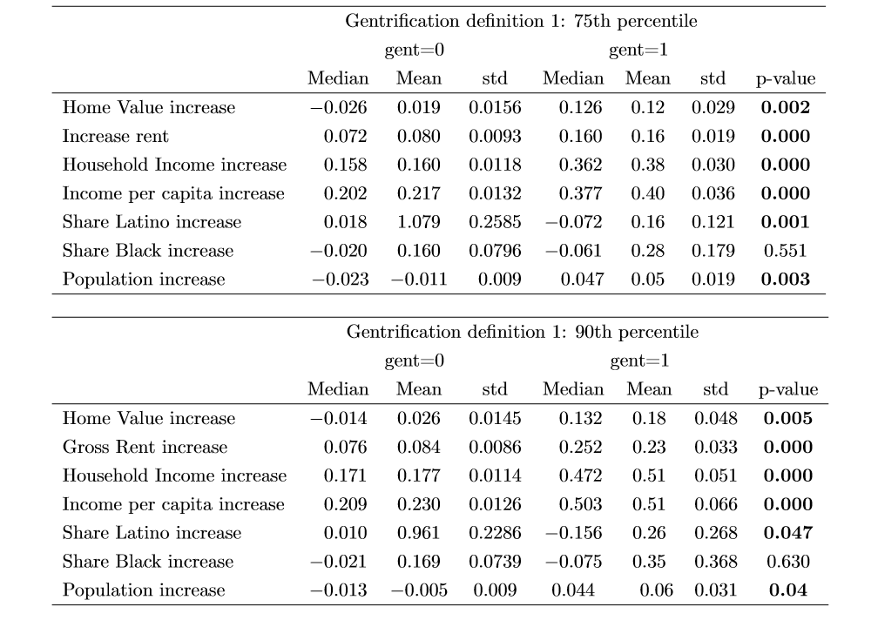
Summary Statistics – Changes – Def. #1

Slide 23
Comments on summary statistics for changes in outcomes under definition 1
Home values, rents, income, and population increase significantly in gentrified tracts
Gentrification occurs mainly in Latino tracts and neighborhoods
Share of black or African American individuals decline in both gentrified and not gentrified tracts
Home values increased between 12% and 18%, and rents increased between 16% and 23% in gentrified tracts between 2013 and 2018

Slide 24
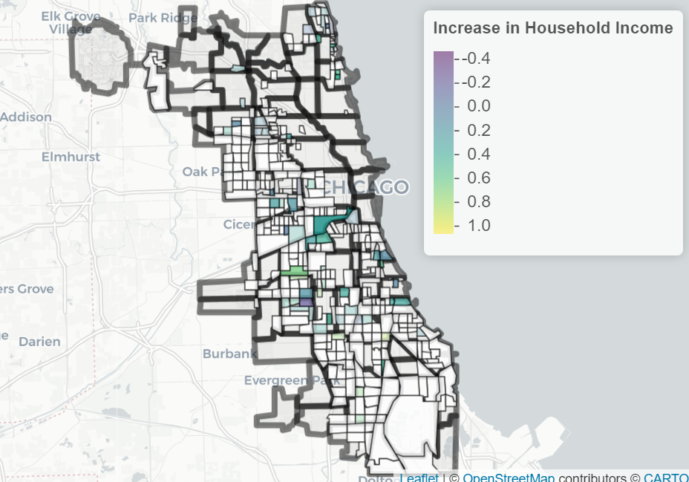
Increase in median income under defition #2 at the 75th percentile

Slide 25
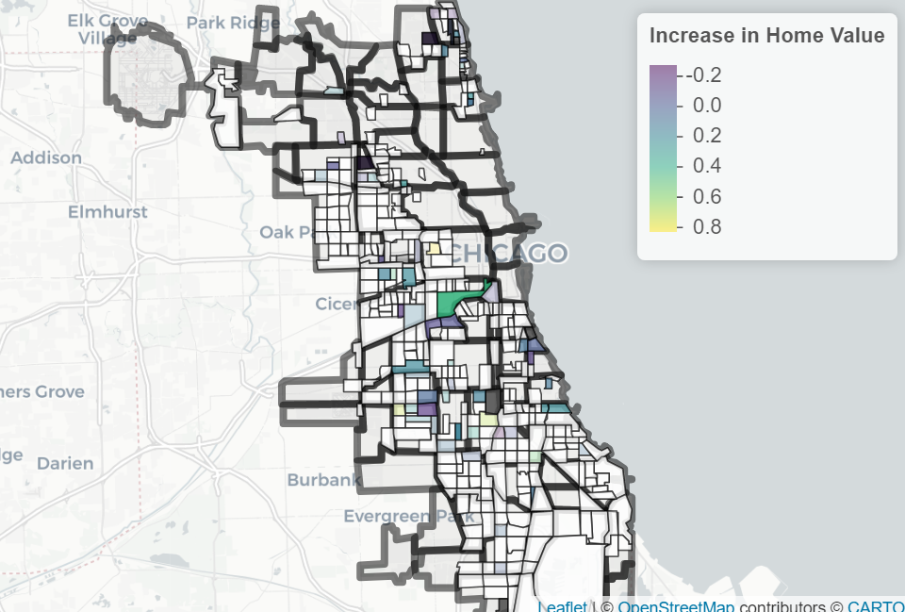
Increase in home values under definition #2 at the 75th percentile

Slide 26
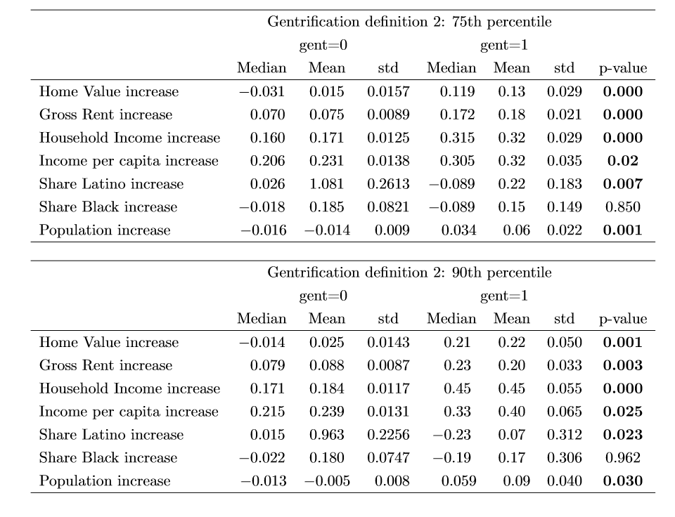
Summary Statistics – Changes – Def. #2

Slide 27
Comments on summary statistics under def #2
Home values, rents, income, and population increase significantly in gentrified tracts according to definition 2
Gentrification locates significantly more in Latino tracts.
Home values increase on average between 13% and 22%, and rents increase between 18% and 20% in gentrified tracts

Slide 28
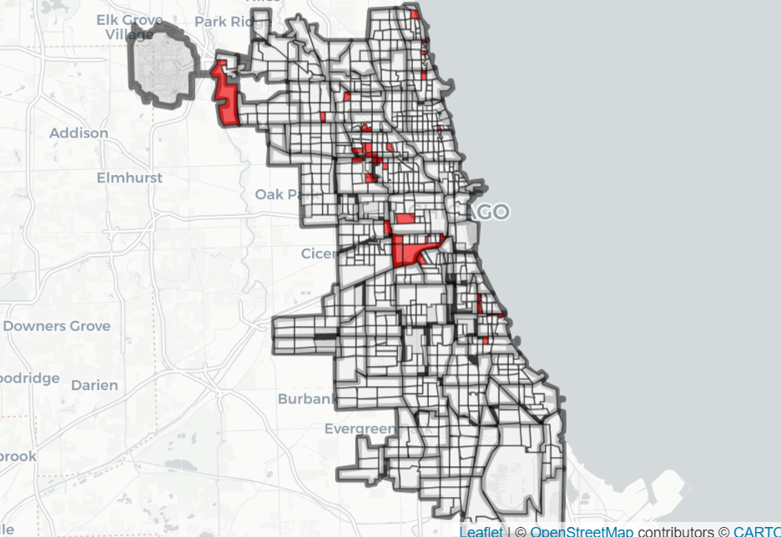
Gentrified Tracts under both definitions at the 75th percentile

Slide 29
Recommendations for legislation
Reduce $100,000 requirement for the AMI ($81,900 April 2020 for household size of 3)
Reduce $75,000 requirement for the 80% AMI ($65,550 April 2020 for household size of 3)
Reduce increase in home value requirement from 10% to 5% (26% increase over 5 years)
Reduce increase in home value requirement from 7% to 3% (16% increase over 5 years)

Slide 30
For More Information
Drazzel Feliu
Research Director, Center for Tax and Budget Accountability
(312) 332-2151
dfeliu@ctbaonline.org
Fernando Garcia
Research Intern, Center for Tax and Budget Accountability and
MPP Candidate at Harris School of Public Policy
(312) 866-2886
garciaf@uchicago.edu
.
CTBA's principal goal is to ensure major policy systems work to promote social and economic justice. You can help strengthen our efforts by making a tax-deductible donation at www.ctbaonline.org/donate

